Slide 1
django
yes, the movie
jk ur a fool

Slide 2
last week
regexes!
urls!
models!
views!
templates!
exclamation points!!!!!!!!!!!!!!!!!!!!!

Slide 3
this week
admin!
moar templates!
migrations!
gifs!
fewer exclamation points.
jk!!!!!!!!!!!!!!!!!!!!!!!

Slide 4

non-technical users

Slide 5
non-technical users
need to upload content
don't know shit about computers
how do they do it?

Slide 6
admin interface!
automagically generates CRUD interface
also pretty customizable

Slide 7
but how to?
create file <app_name>/admin.py
import admin
register your model with admin

Slide 8
admin.py
from django.contrib import admin
from blogger.models import BlogPost, Author
admin.site.register(BlogPost) admin.site.register(Author)

Slide 9
is it really that easy?
yes.
yes it is.

Slide 10
some customization
ModelAdmin - class that contains settings

Slide 11
some customization
from django.contrib import admin
from blogger.models import BlogPost, Author
class BlogPostAdmin(admin.ModelAdmin):
fields = ['title', 'post', 'time', 'author']
admin.site.register(BlogPost, BlogPostAdmin)

Slide 12
moar customization
widgets
forms
css i guess if that's what you're into

Slide 13

templates

Slide 14
going back to our blog site...
jk
that shit was boring
let's talk kanye

Slide 15
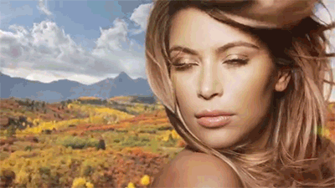
going back to our blog site...

Slide 16
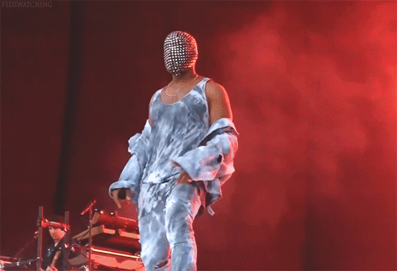
going back to our blog site...

Slide 17

going back to our blog site...

Slide 18
#1 kanye fan site
^$: homepage
^/quote/\d+$: quote page
^/fan/rank_\d+$: ye's number n fan

Slide 19
index.html
<html>
<head>
<title>kanye's biggest baddest fansite</title>
</head>
<body>
<ul id="best quotes">
{% for q in quotes %}
<li><a href="{{ q.url }}">{{ q }}</a></li>
{% endfor %}
</ul>
</body>
</html>

Slide 20
quotes.html
<html>
<head>
<title>kanye's biggest baddest fansite</title>
</head>
<body>
<h1>quote</h1>
<p id="quote">{{ quote }}</p>
<div id="comments">
...
</div>
</body>
</html>

Slide 21
fan.html
<html>
<head>
<title>kanye's biggest baddest fansite</title>
</head>
<body>
<h1>kanye's #{{ fan.rank }} fan</h1>
<span id="name">{{ fan.name }}</span>
<div id="stats">
{{ fan.stats }}
</div>
</body>
</html>

Slide 22
what's wrong with this picture?

Slide 23
template inheritance
define "base" template
define "blocks"
child templates fill in blocks

Slide 24
_base.html
<html>
<head>
<title>kanye's biggest baddest fansite</title>
</head>
<body>
{% block content %} {% endblock content %}
</body>
</html>

Slide 25
index.html (w/ facelift)
{% extends "_base.html" %}
{% block content %}
<ul id="best quotes">
{% for q in quotes %}
<li><a href="{{ q.url }}">{{ q }}</a></li>
{% endfor %}
</ul>
{% endblock content %}

Slide 26
logic in templates (yay!)
template filters!
define functions!
transform your inputs!
moar info!

Slide 27
how to make
create directory <your_app>/templatetags
create files
templatetags/__init__.py
templatetags/my_templatetags.py

Slide 28
my_templatetags.py
from django import template
register = template.Library()
@register.filter()
def excite(val):
return val.upper()

Slide 29
usage (blog_post.html)
{% extends "base.html" %}
{% load blogger_extras %}
{% block content %}
<h1>{{ post.title|excite }}</h1>
... more stuff here too probably
{% endblock %}

Slide 30
migrations :o
guys guys guys
huge development guys
i added a field to the model :o
wat do

Slide 31
migrations
you add a field to your models
you run python manage.py makemigrations
python manage.py makemigrations –name changed_my_model your_app_label
creates migration file

Slide 32
but what is migration file
numbered
code automatically updates db
run them with with python manage.py migrate

